Slide 1
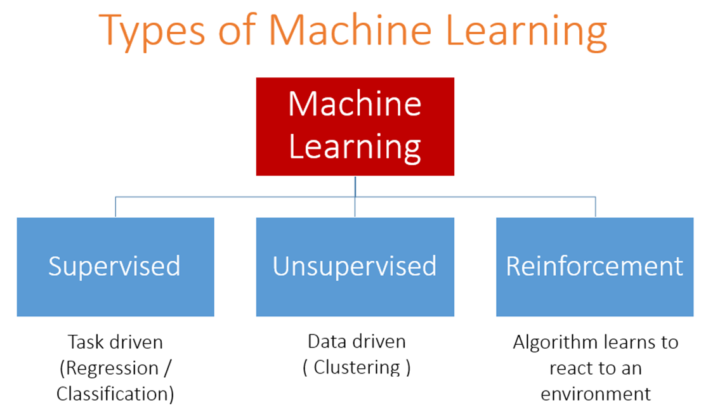
1
An acquaintance of “Data science”
|
Notes:
1

Slide 2
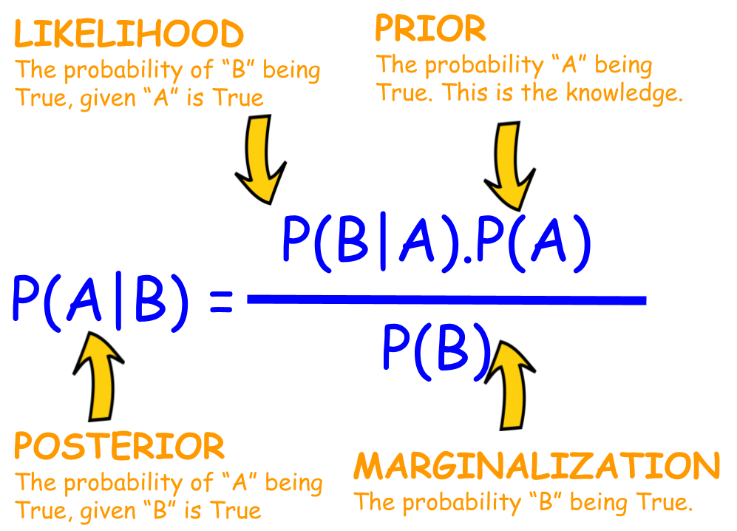

Bayes Theorem
2
An acquaintance of “Data science”
|
Notes:
2

Slide 3
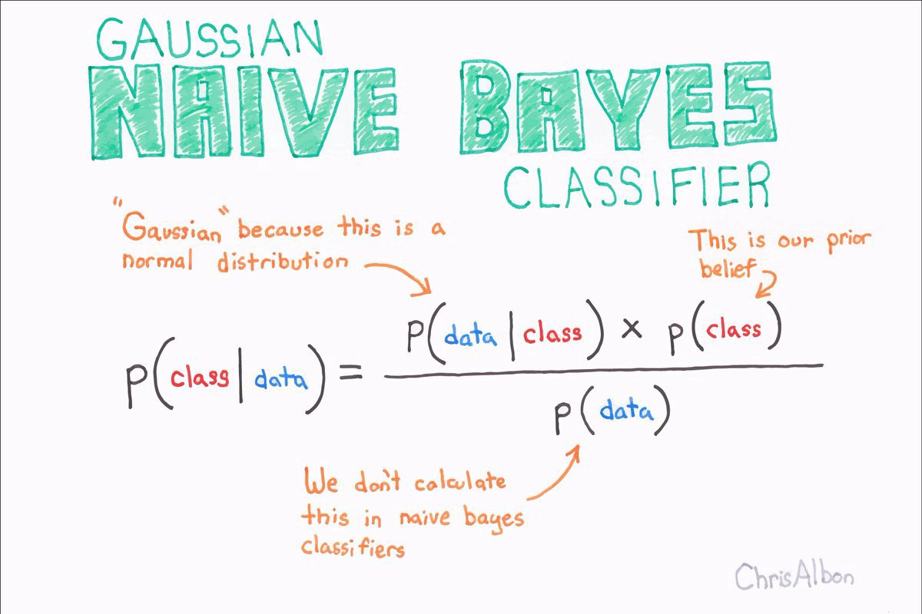
Naive Bayes Classifier
3
An acquaintance of “Data science”
|
Notes:
3

Slide 4
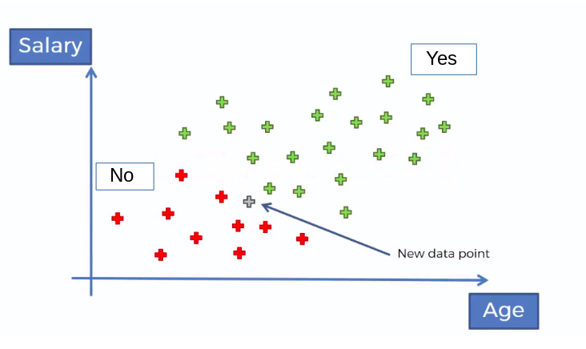
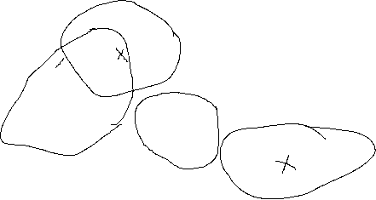

Bayes Theorem in ML = Naive Bayes
4
An acquaintance of “Data science”
|
Notes:
4

Slide 5
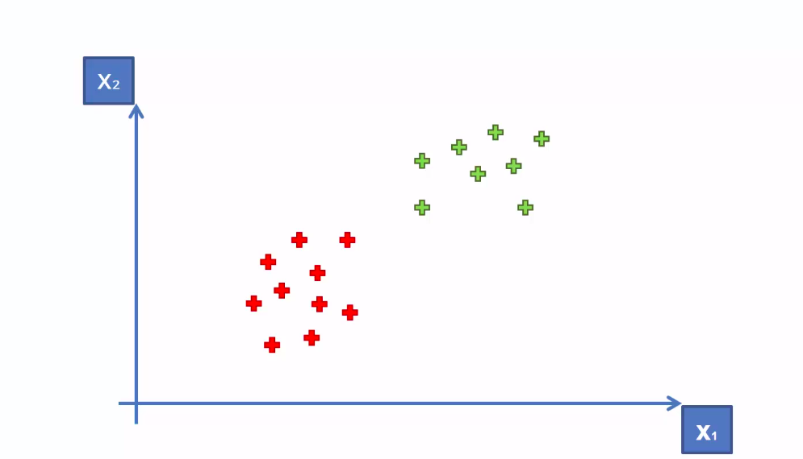
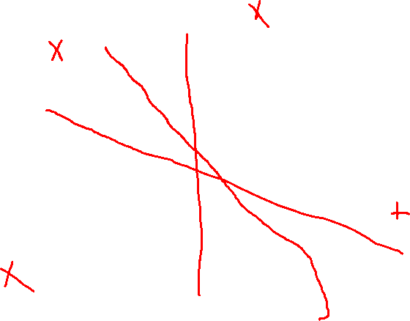
Support Vector Machine(SVM)
5
An acquaintance of “Data science”
|
Notes:
5

Slide 6
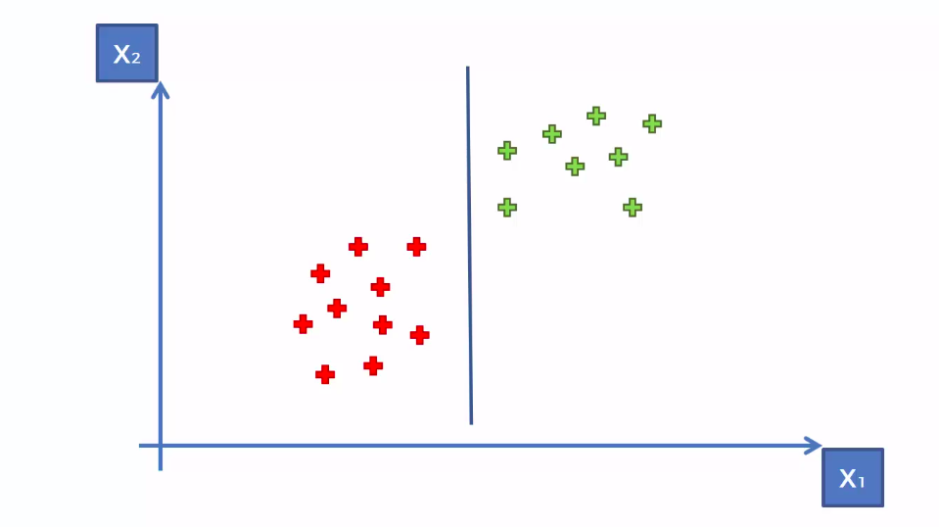
Support Vector Machine(SVM)
6
An acquaintance of “Data science”
|
Notes:
6

Slide 7
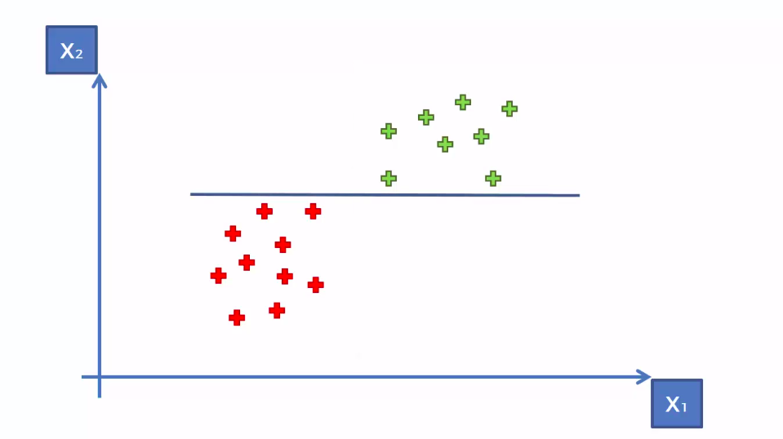
Support Vector Machine(SVM)
7
An acquaintance of “Data science”
|
Notes:
7

Slide 8
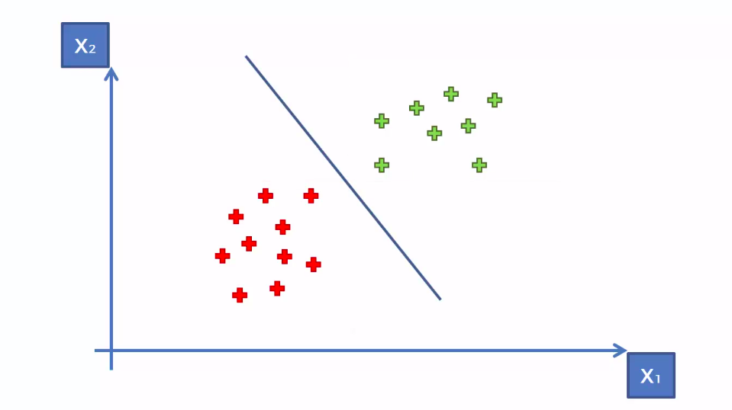
Support Vector Machine(SVM)
8
An acquaintance of “Data science”
|
Notes:
8

Slide 9
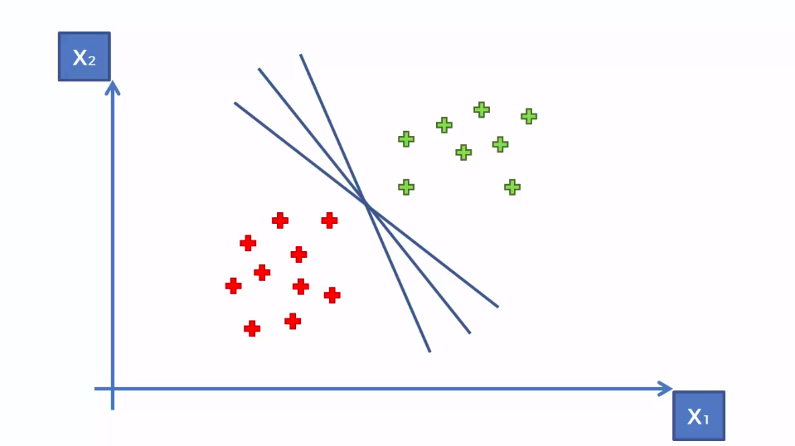

SVM
9
An acquaintance of “Data science”
|
Notes:
9

Slide 10
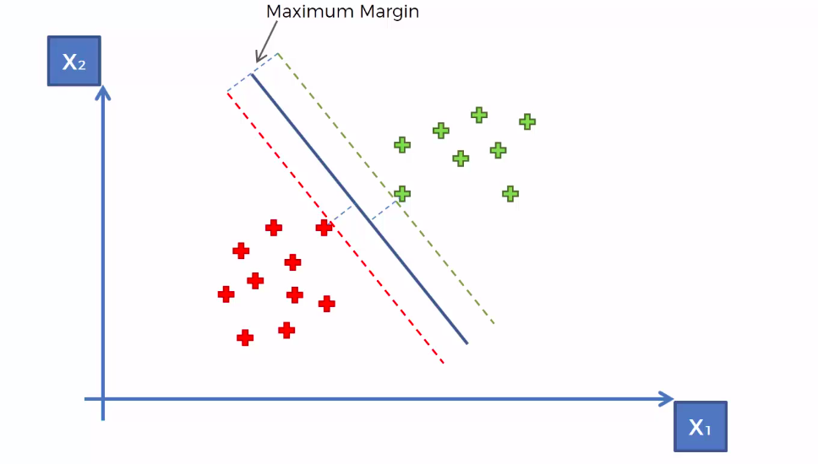


SVM
10
An acquaintance of “Data science”
|
Notes:
10

Slide 11

SVM
11
An acquaintance of “Data science”
|
Notes:
11

Slide 12

Thank you for your attention!
17
|
Notes:
ou
12

